Slide 1

Air Quality
FATIN ISRAQ TABIB (2022280)
SHAH SADMANEY YEASAR SHOPNIL (1730034)
PARVEZ AHMED FAHIM (2021358)

Slide 2
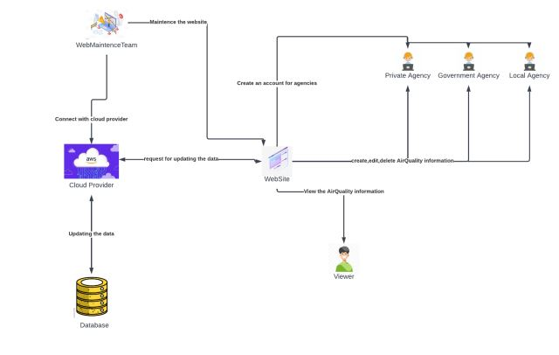
AIR Quality Website Rich Picture

Slide 3
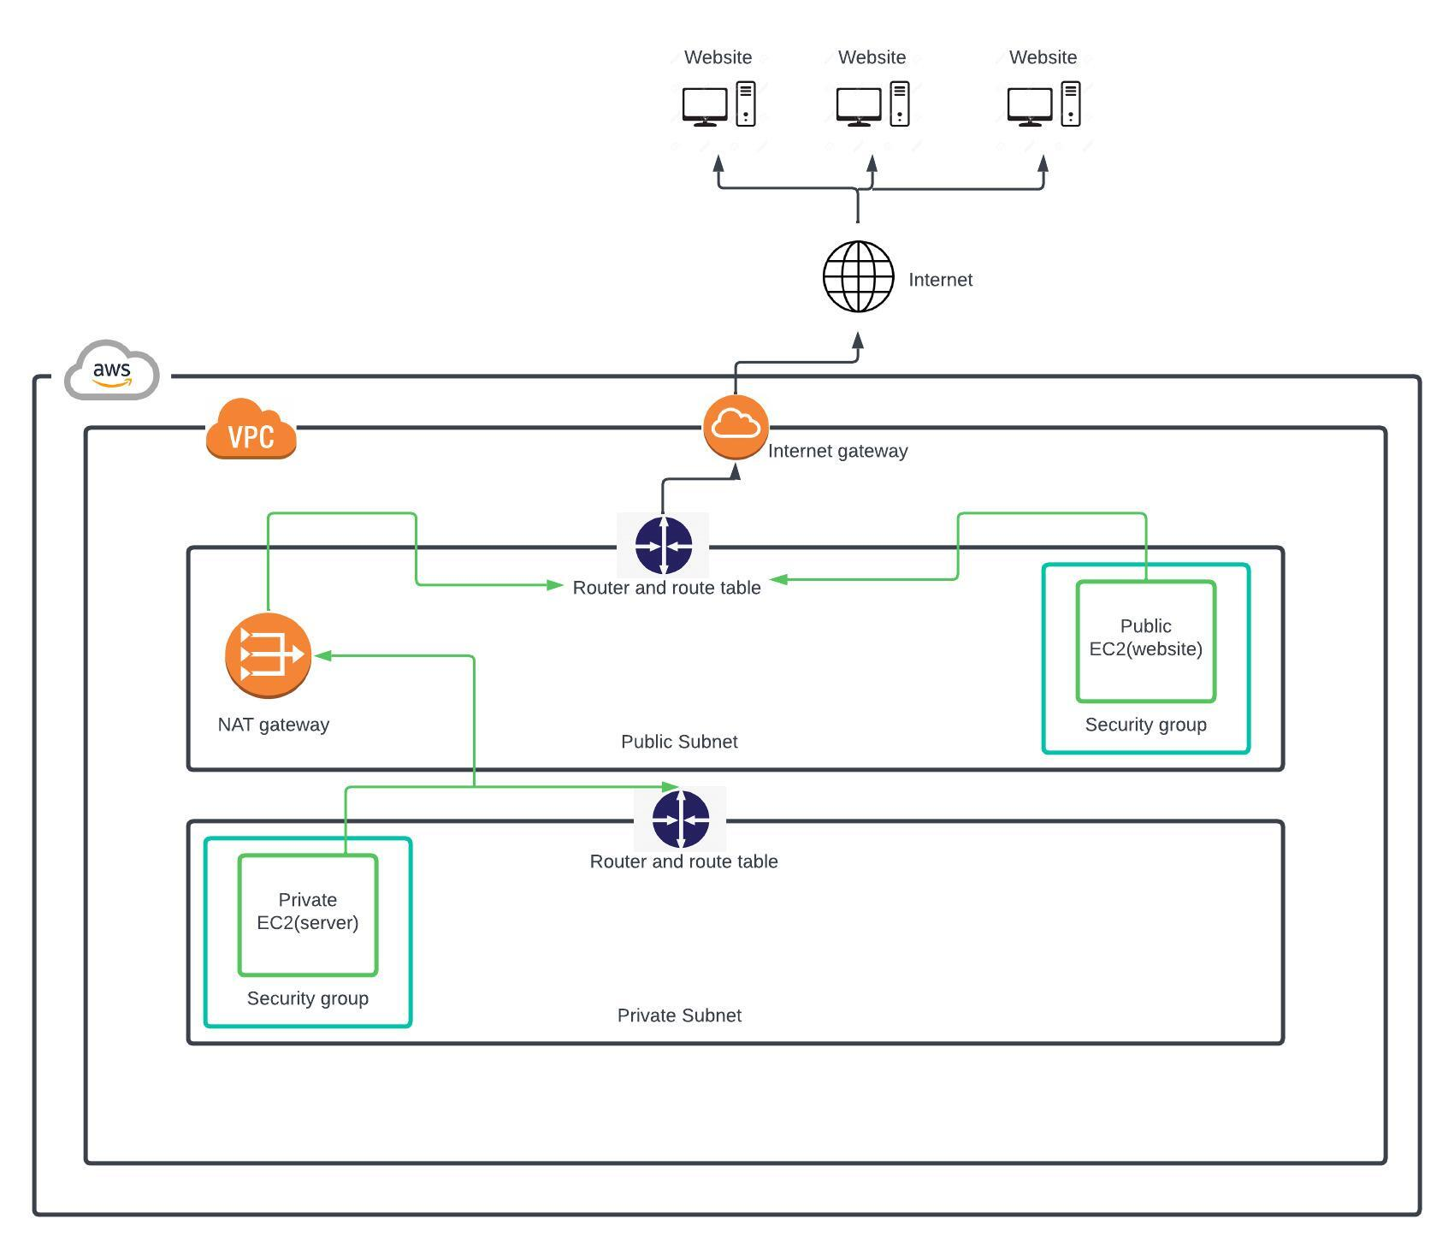
Cloud Architecture For Website

Slide 4

VPC

Slide 5
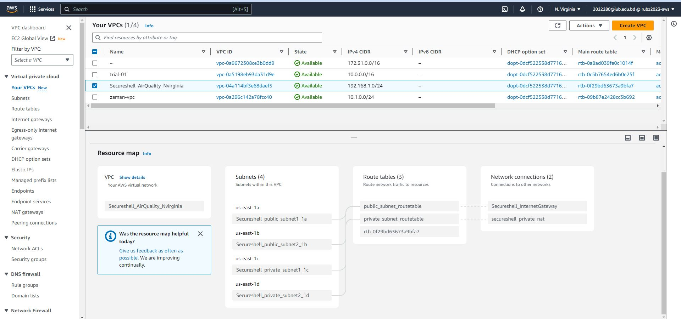
Create a new VPC

Slide 6
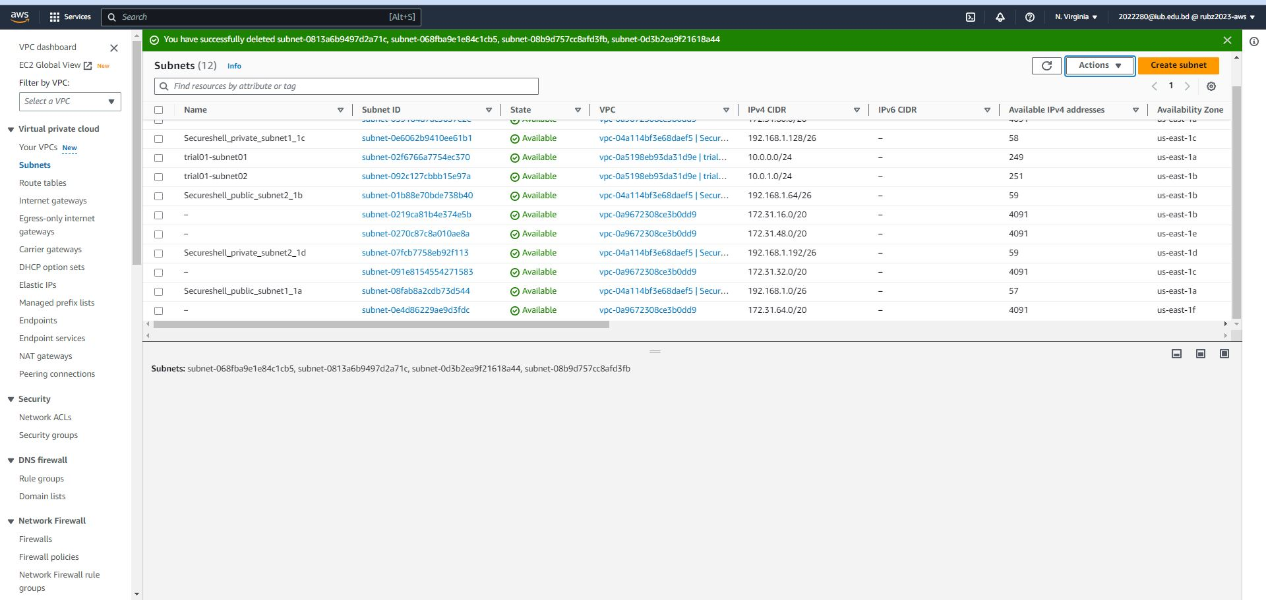
Create 4 new Subnet Under the VPC

Slide 7
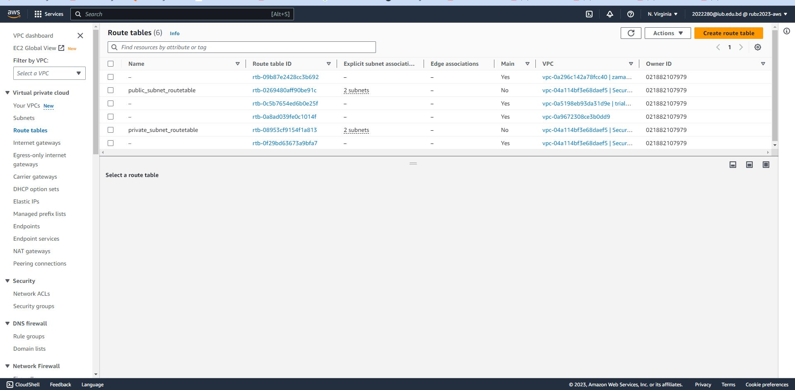
Create Route Table For Subnets

Slide 8
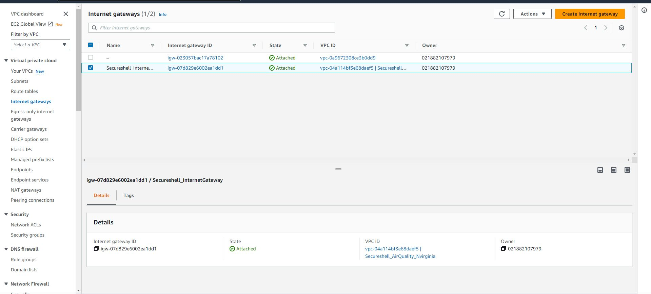
Create Internet Gateway for public subnets

Slide 9
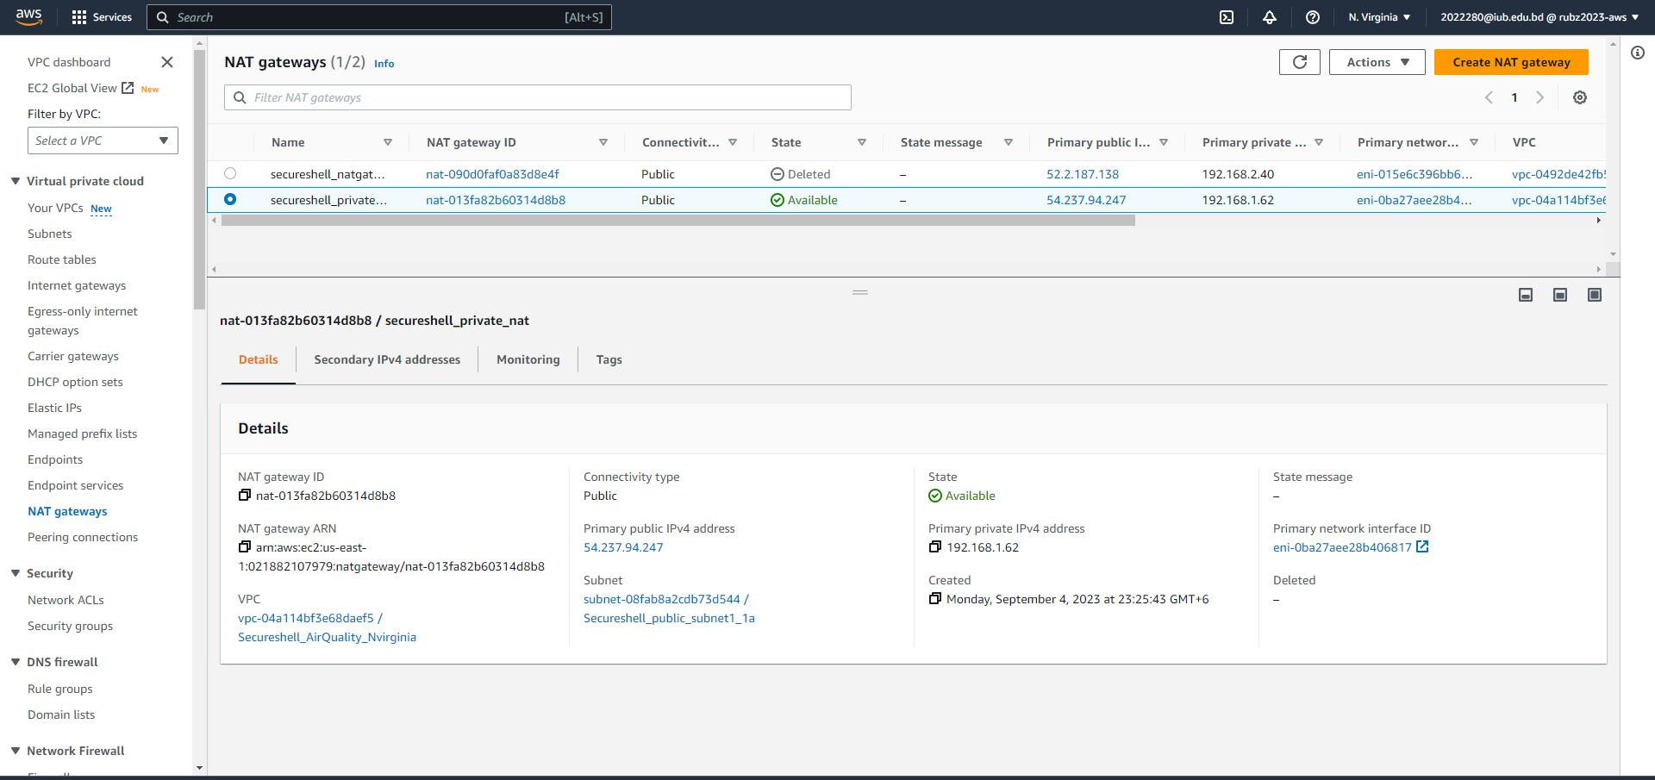
Create Nat Gateway for private subnets

Slide 10
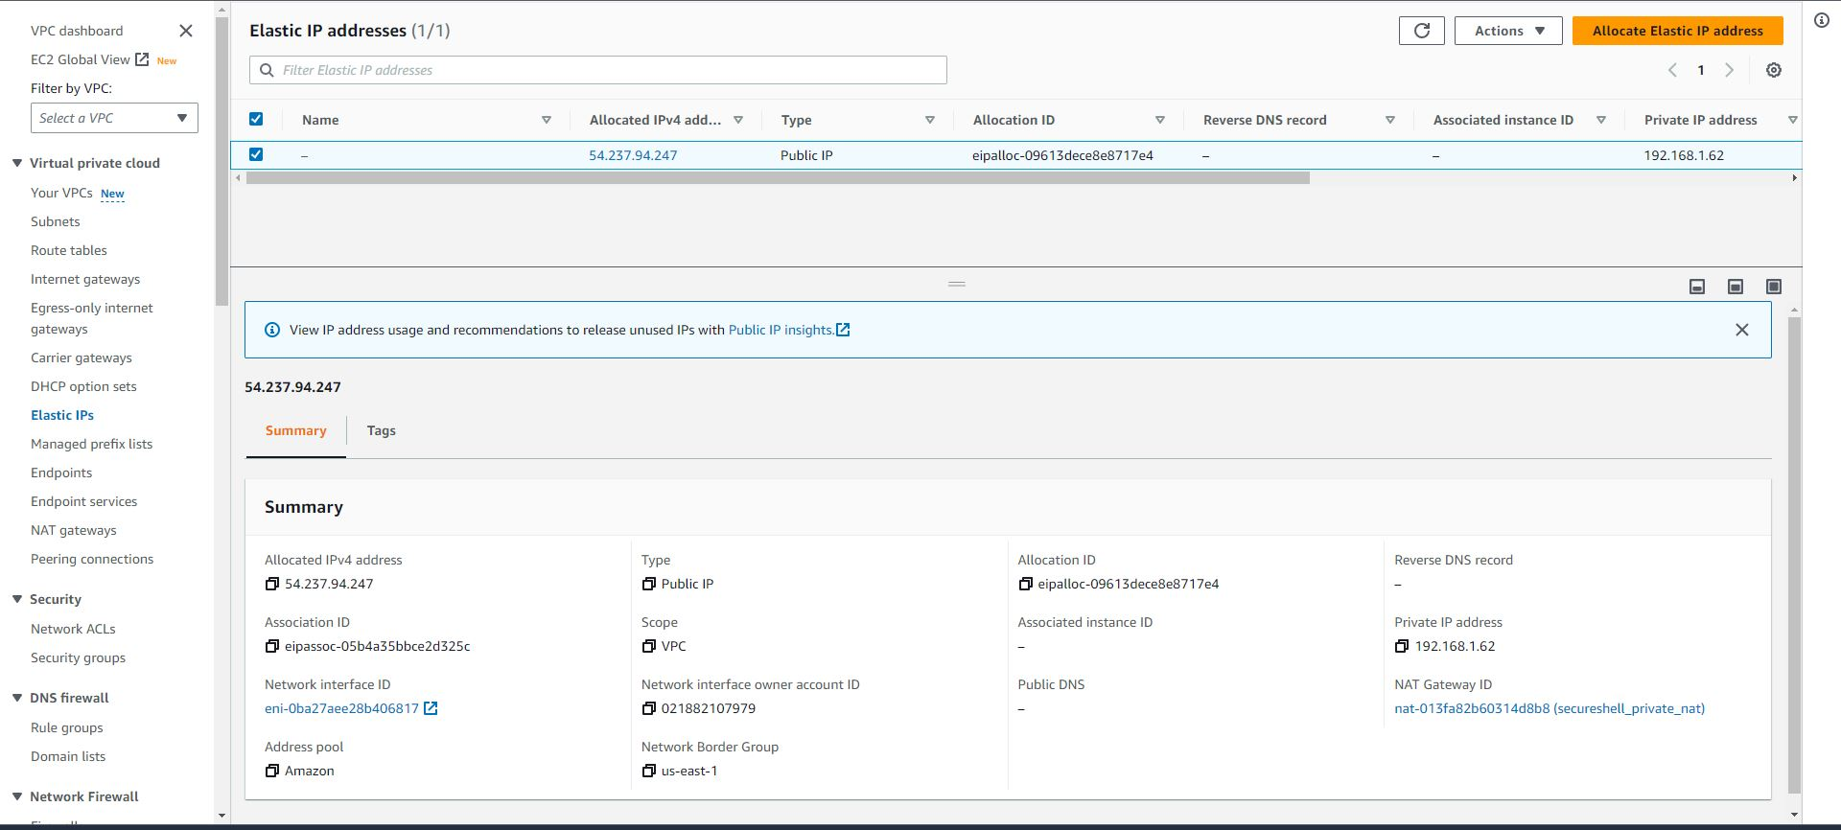
Elastic IP For Nat Gateway

Slide 11
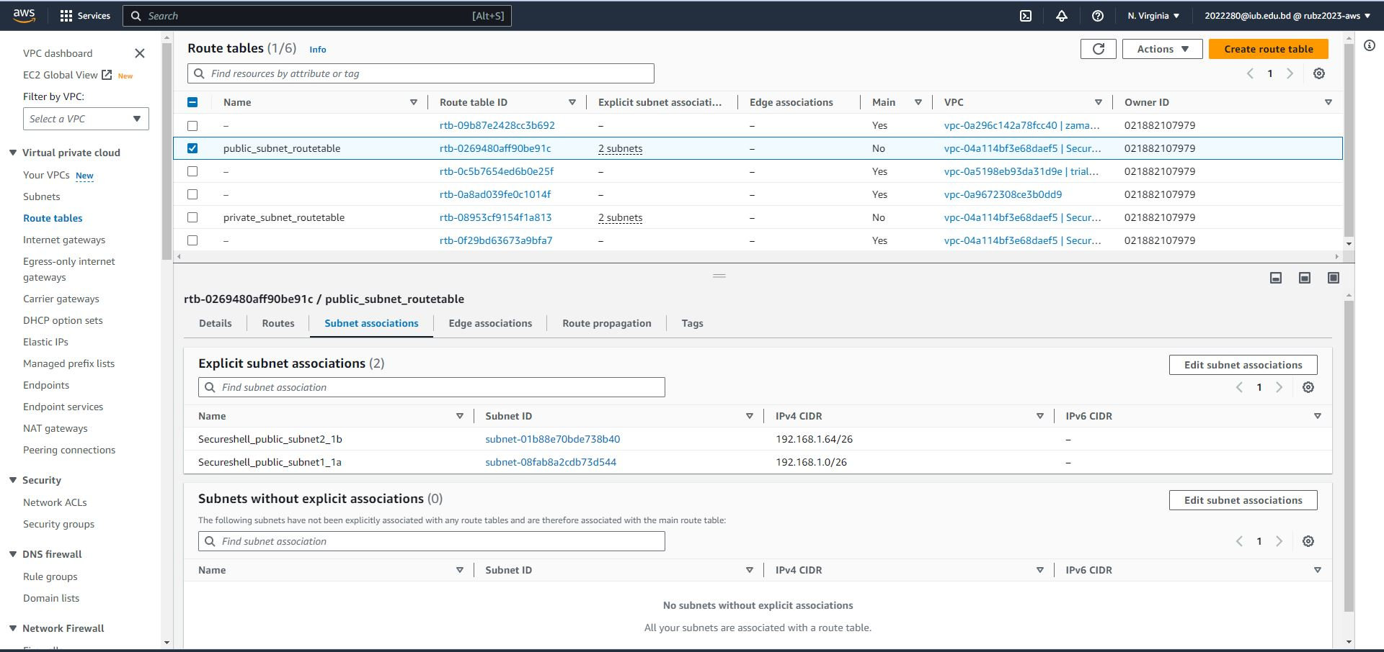
Public Subnets Associations

Slide 12
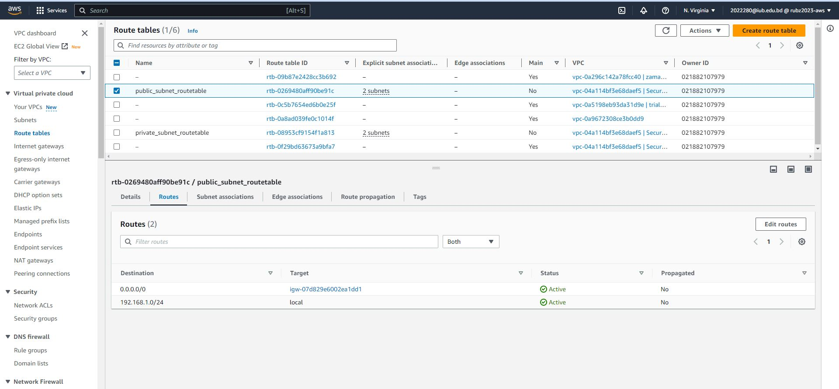
Public Subnets Route

Slide 13
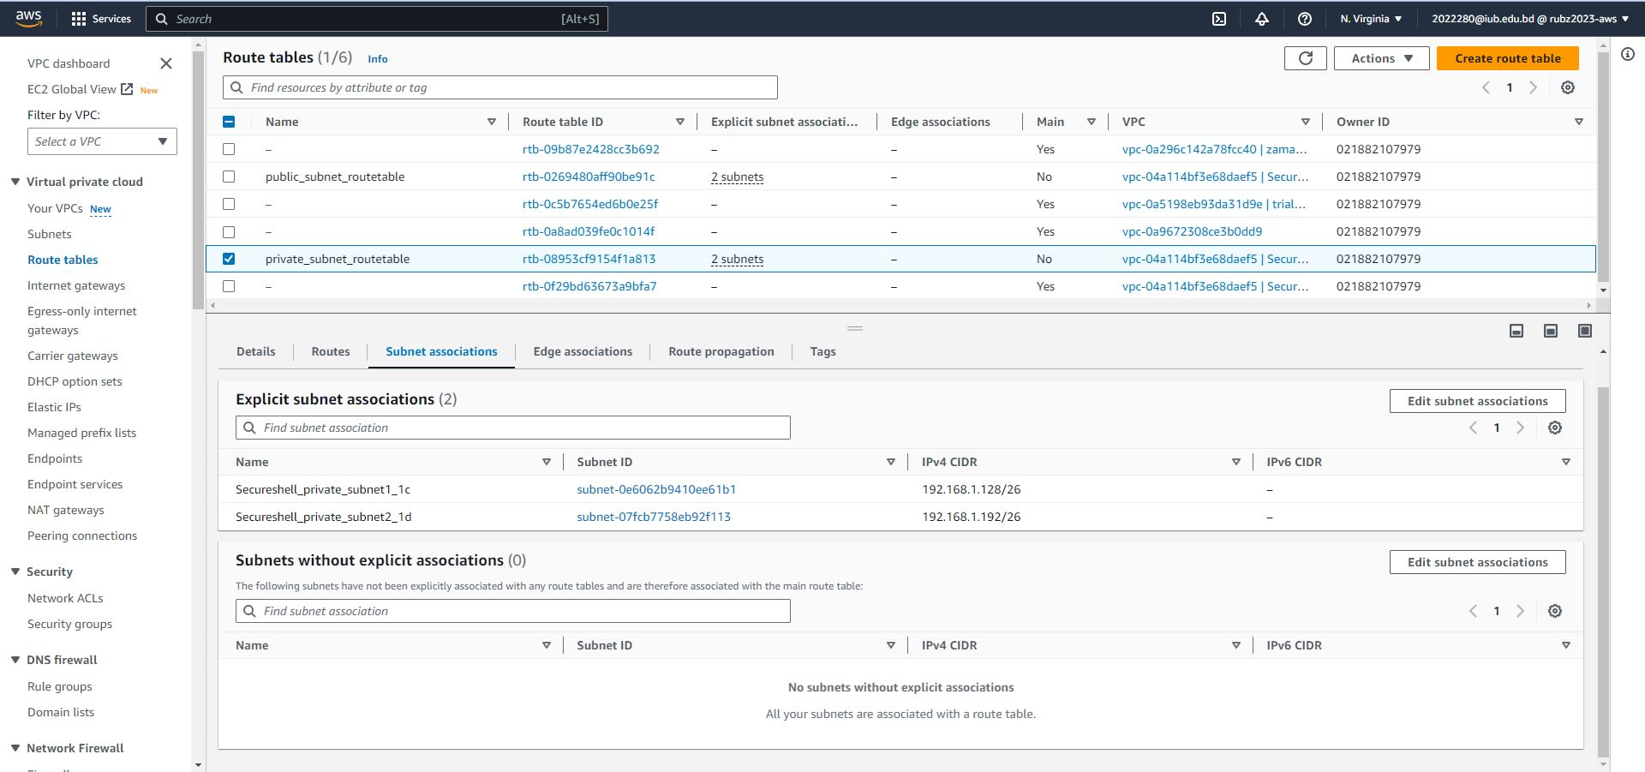
Private Subnets Associations

Slide 14
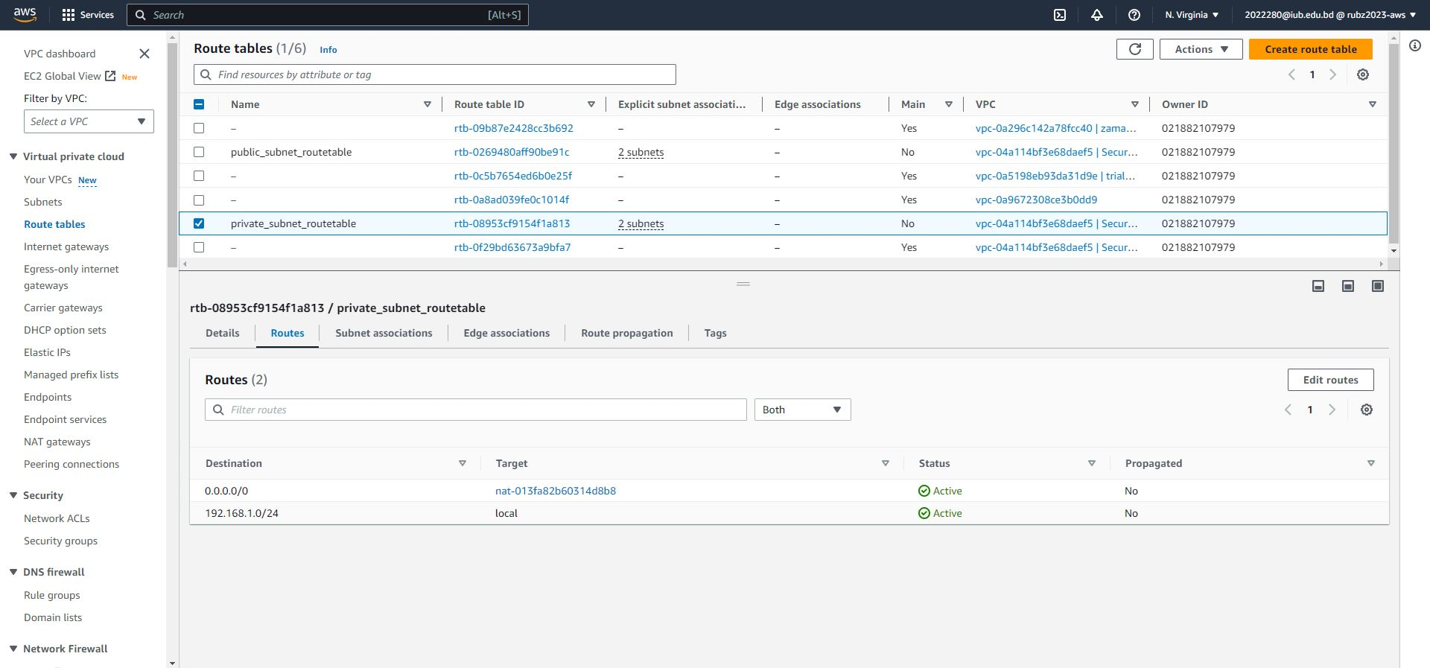
Private Subnets Route

Slide 15

EC2

Slide 16
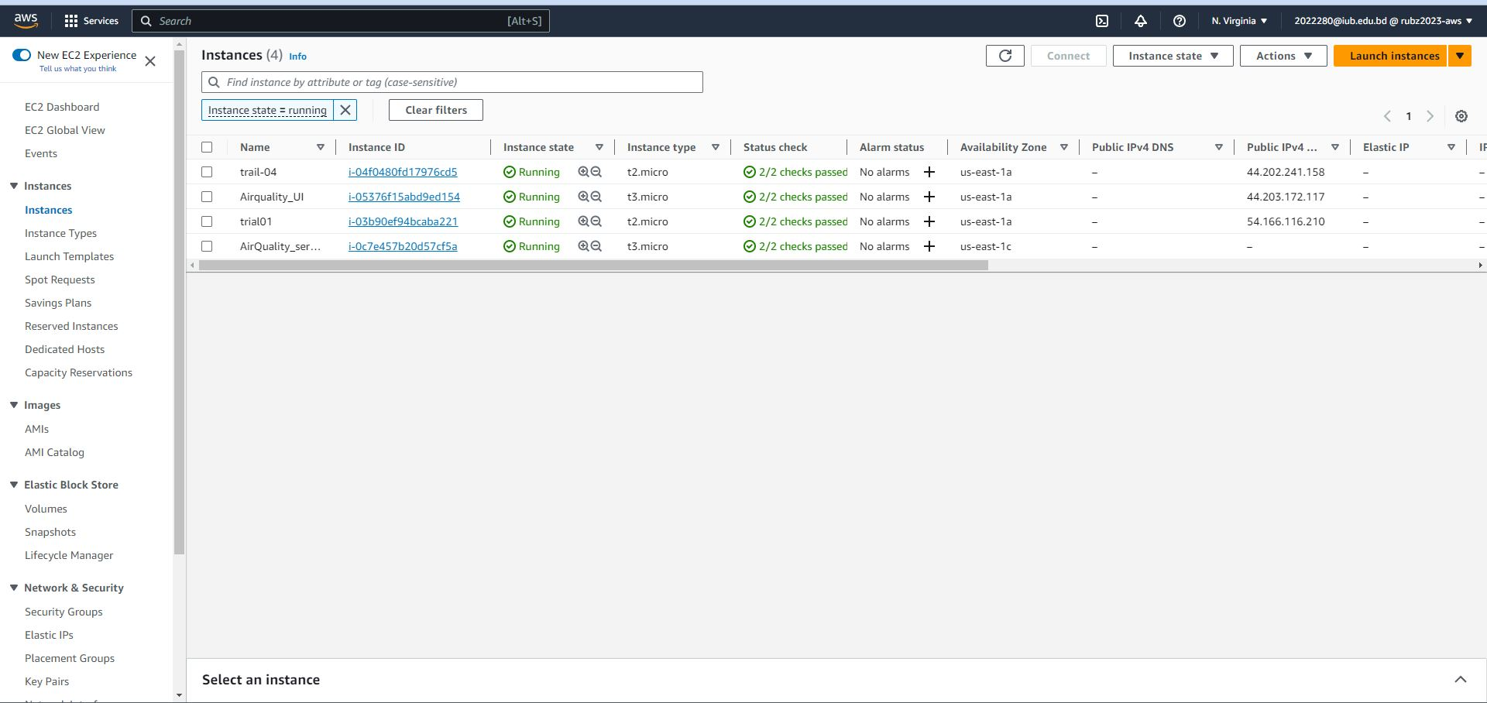
Create 2 Windows EC2 Instance. One for public and one for private network

Slide 17
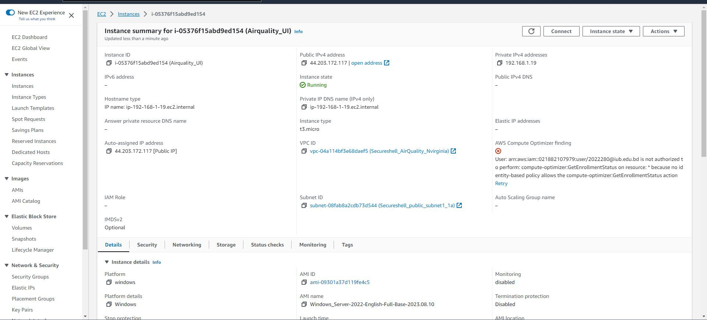
Public Instance

Slide 18
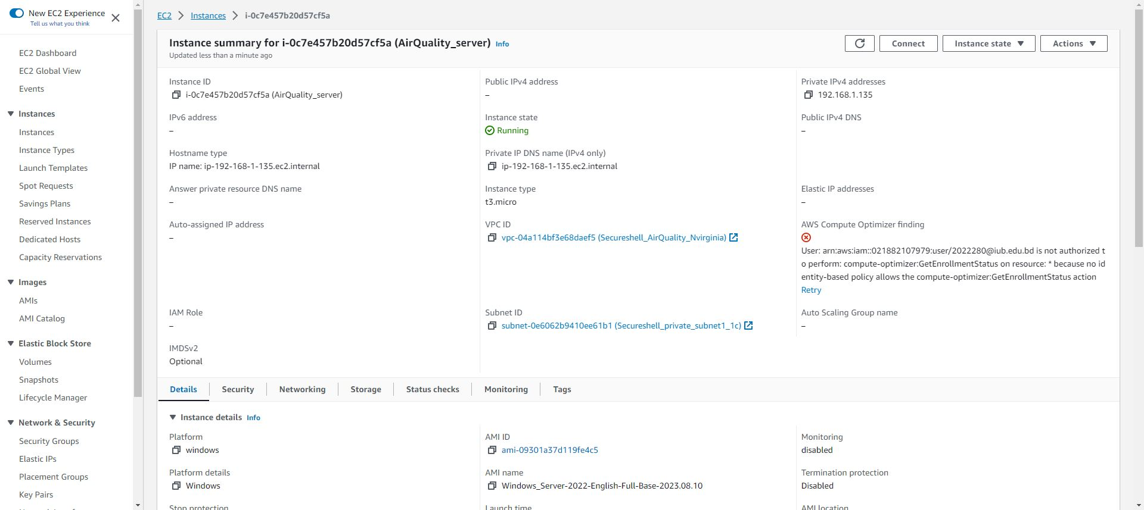
Private Instance

Slide 19
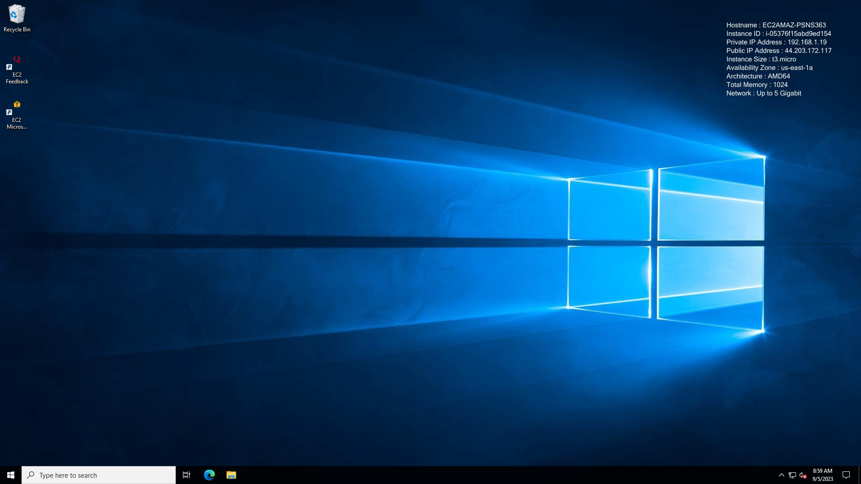

Public Instance
RDP To The Instances
Private Instance

Slide 20
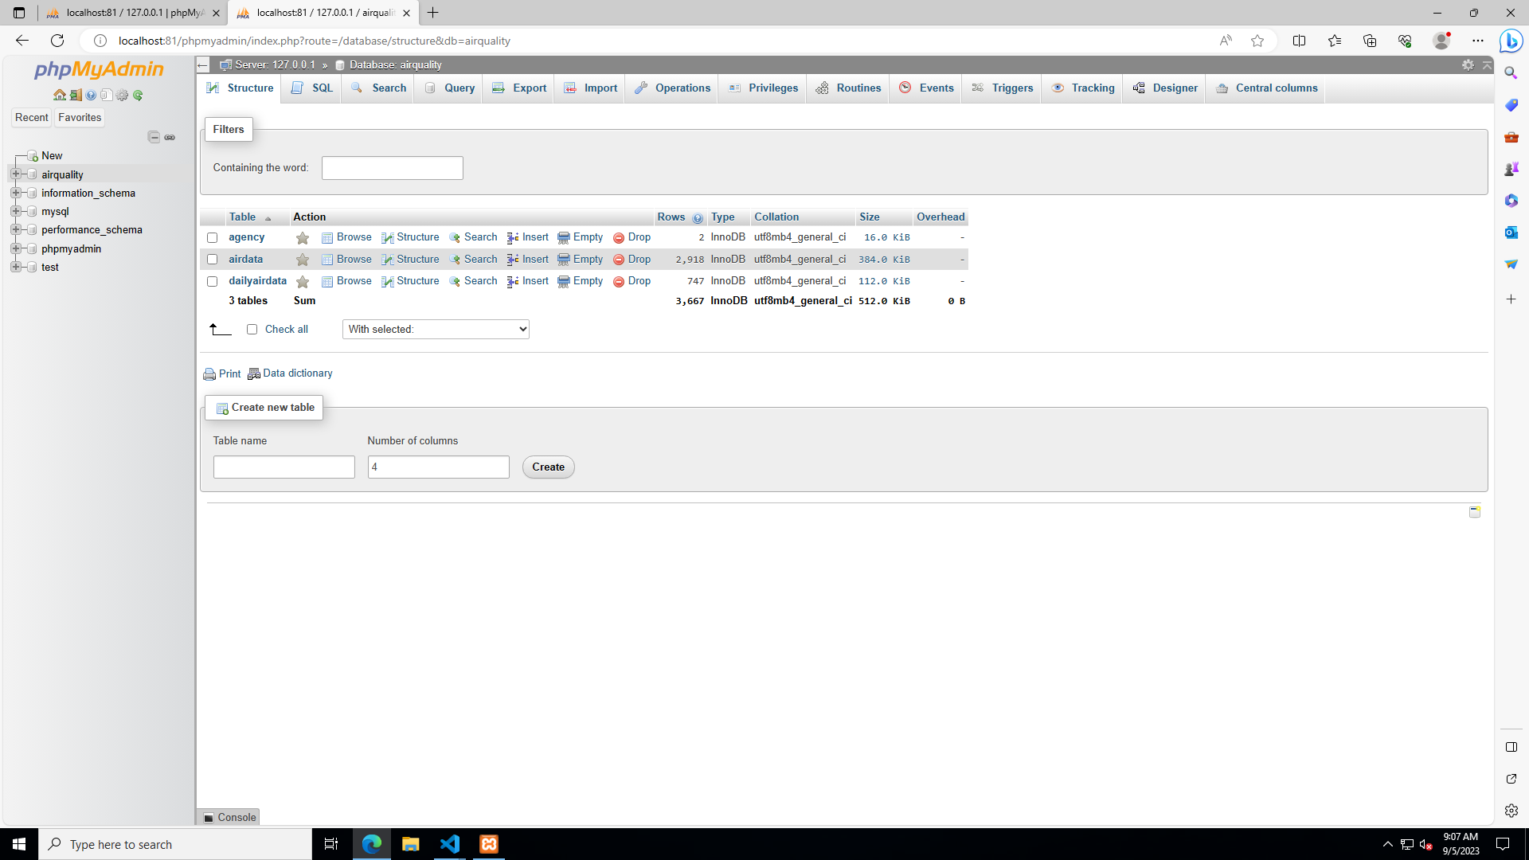
Database On Private Instance

Slide 21
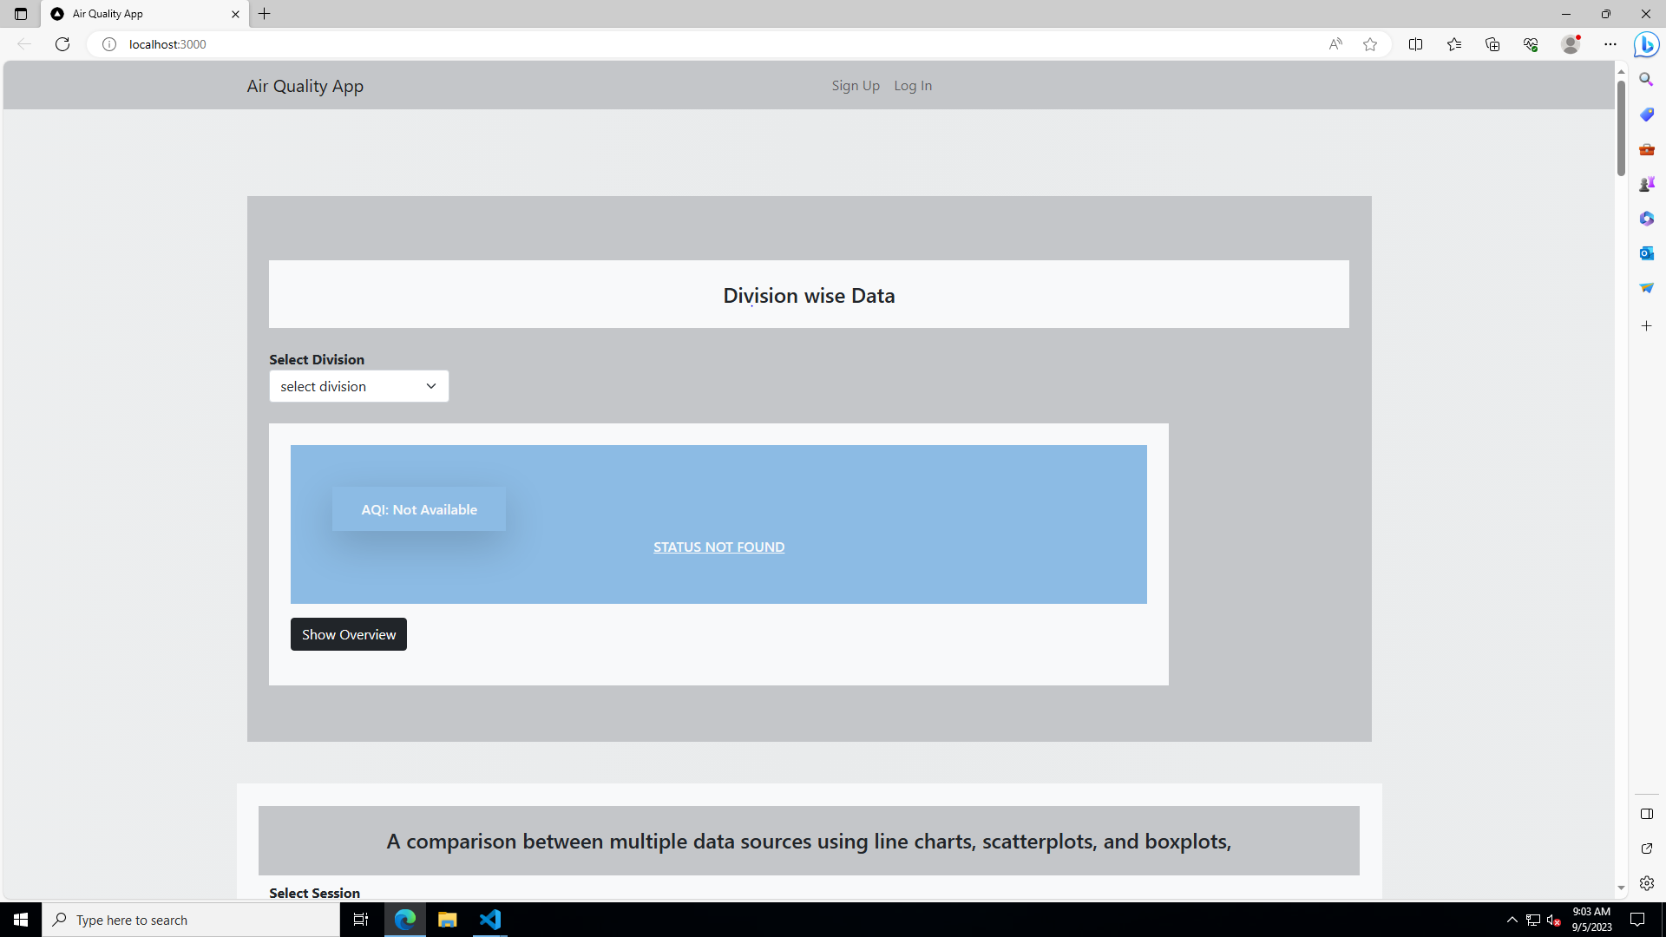
Website Locally Run on public Instance

Slide 22


Auto scaling
&
Load Balancer

Slide 23
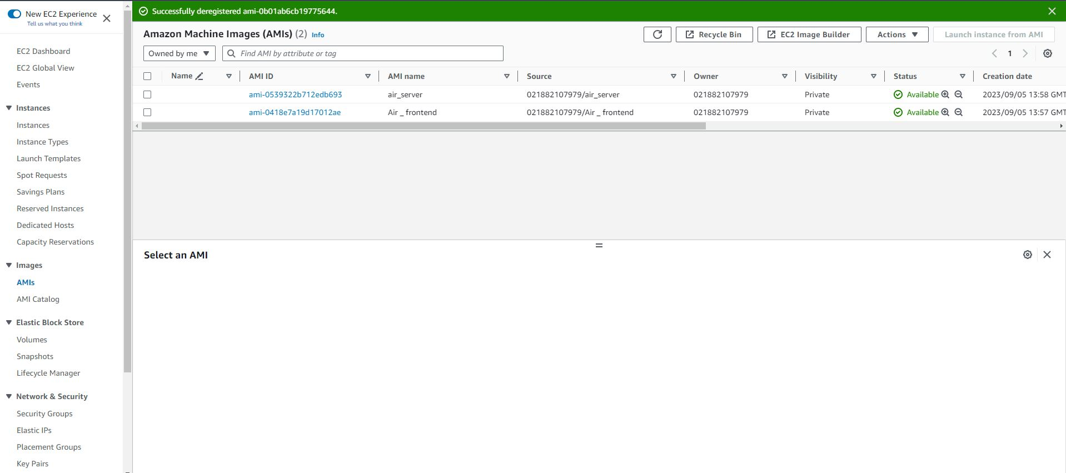
AMI From The Public And Private Instances

Slide 24
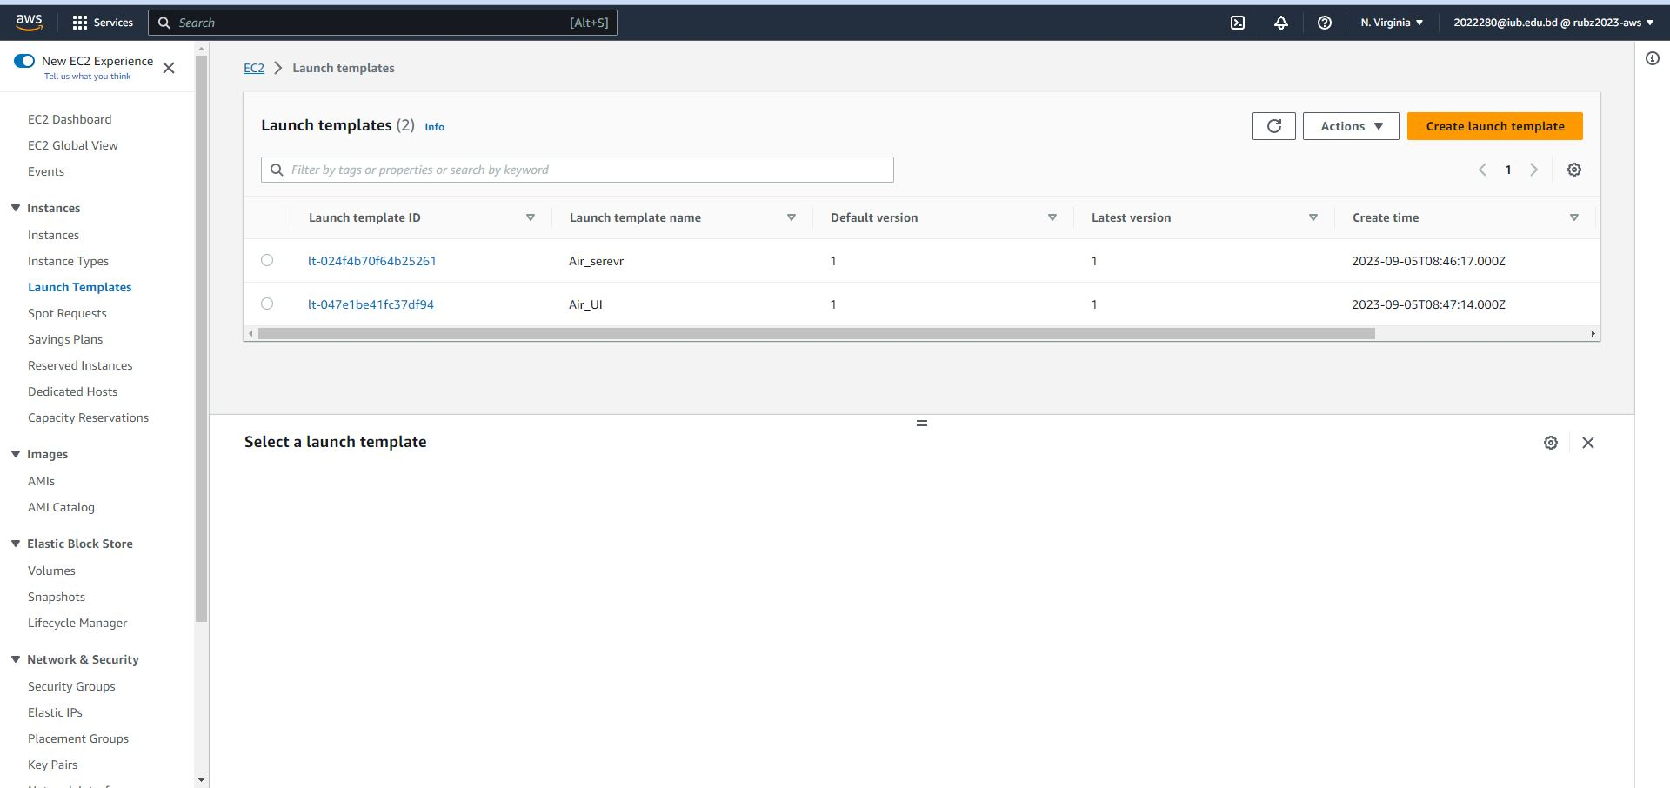
Launch Template For The Public And Private Instances

Slide 25
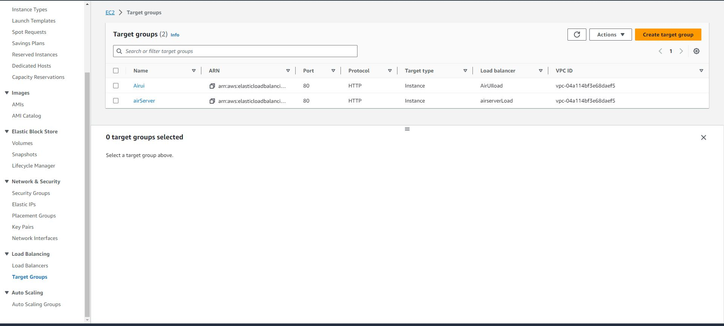
Target Group For The Public And Private Instances

Slide 26
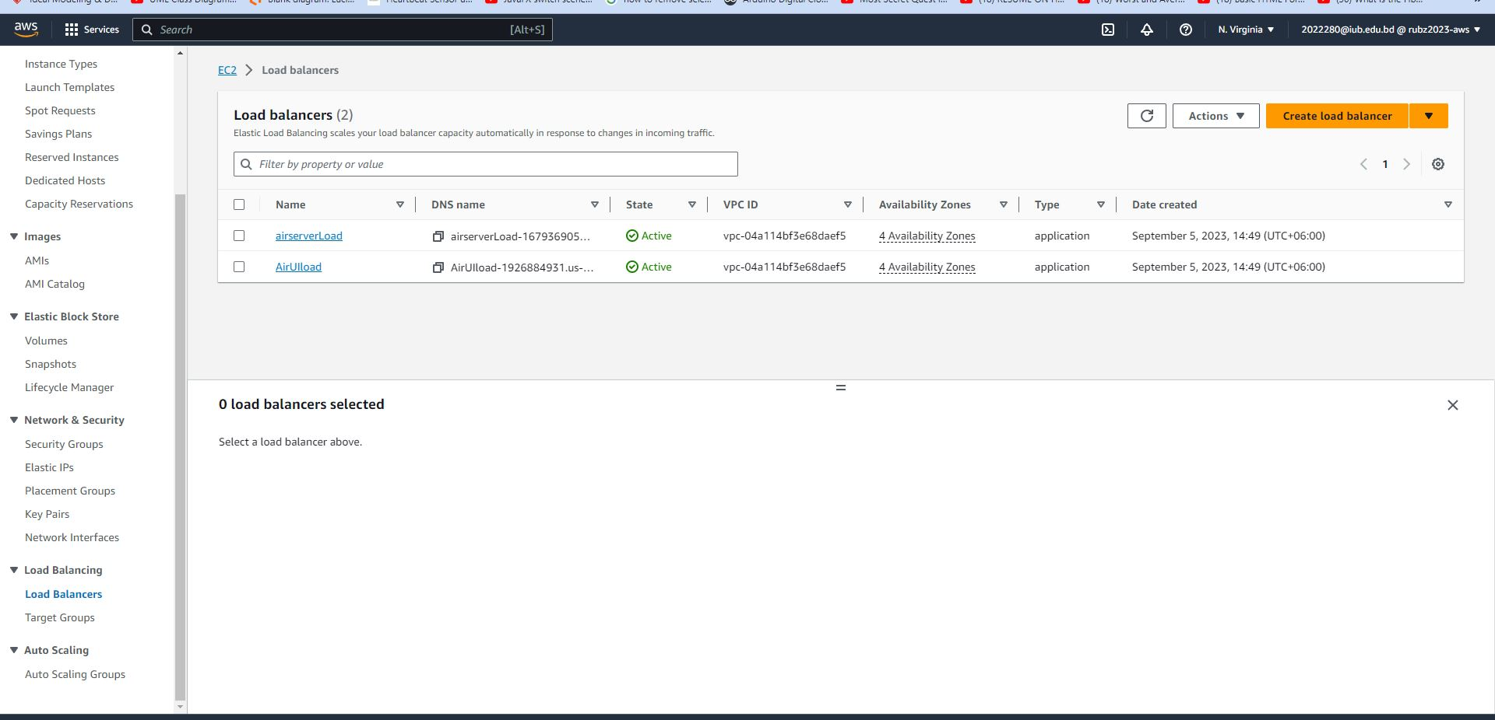
Load Balancer For The Public And Private Instances

Slide 27
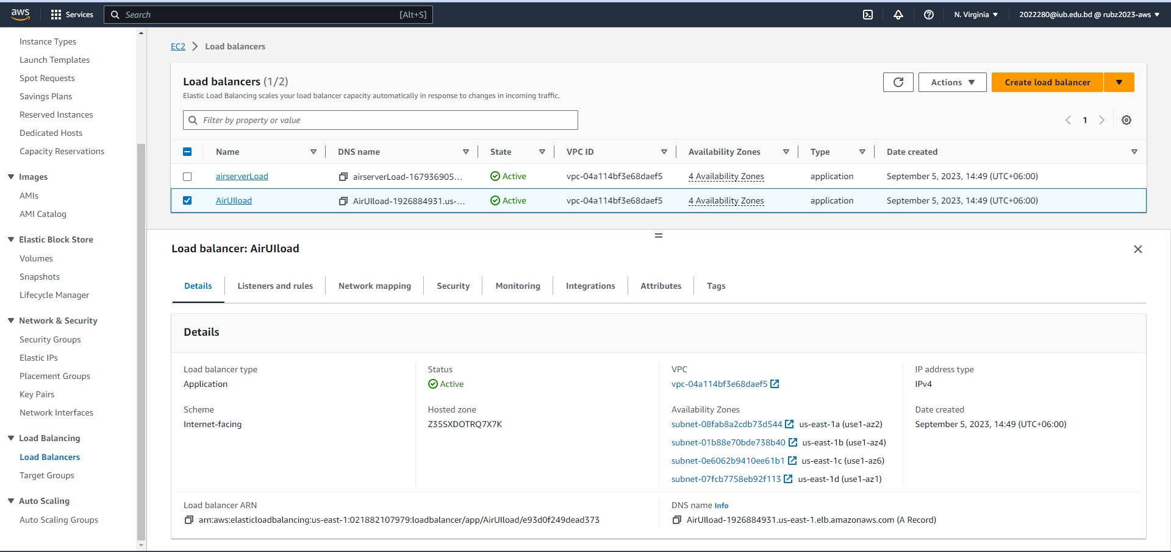
Load Balancer For The Public Instances

Slide 28
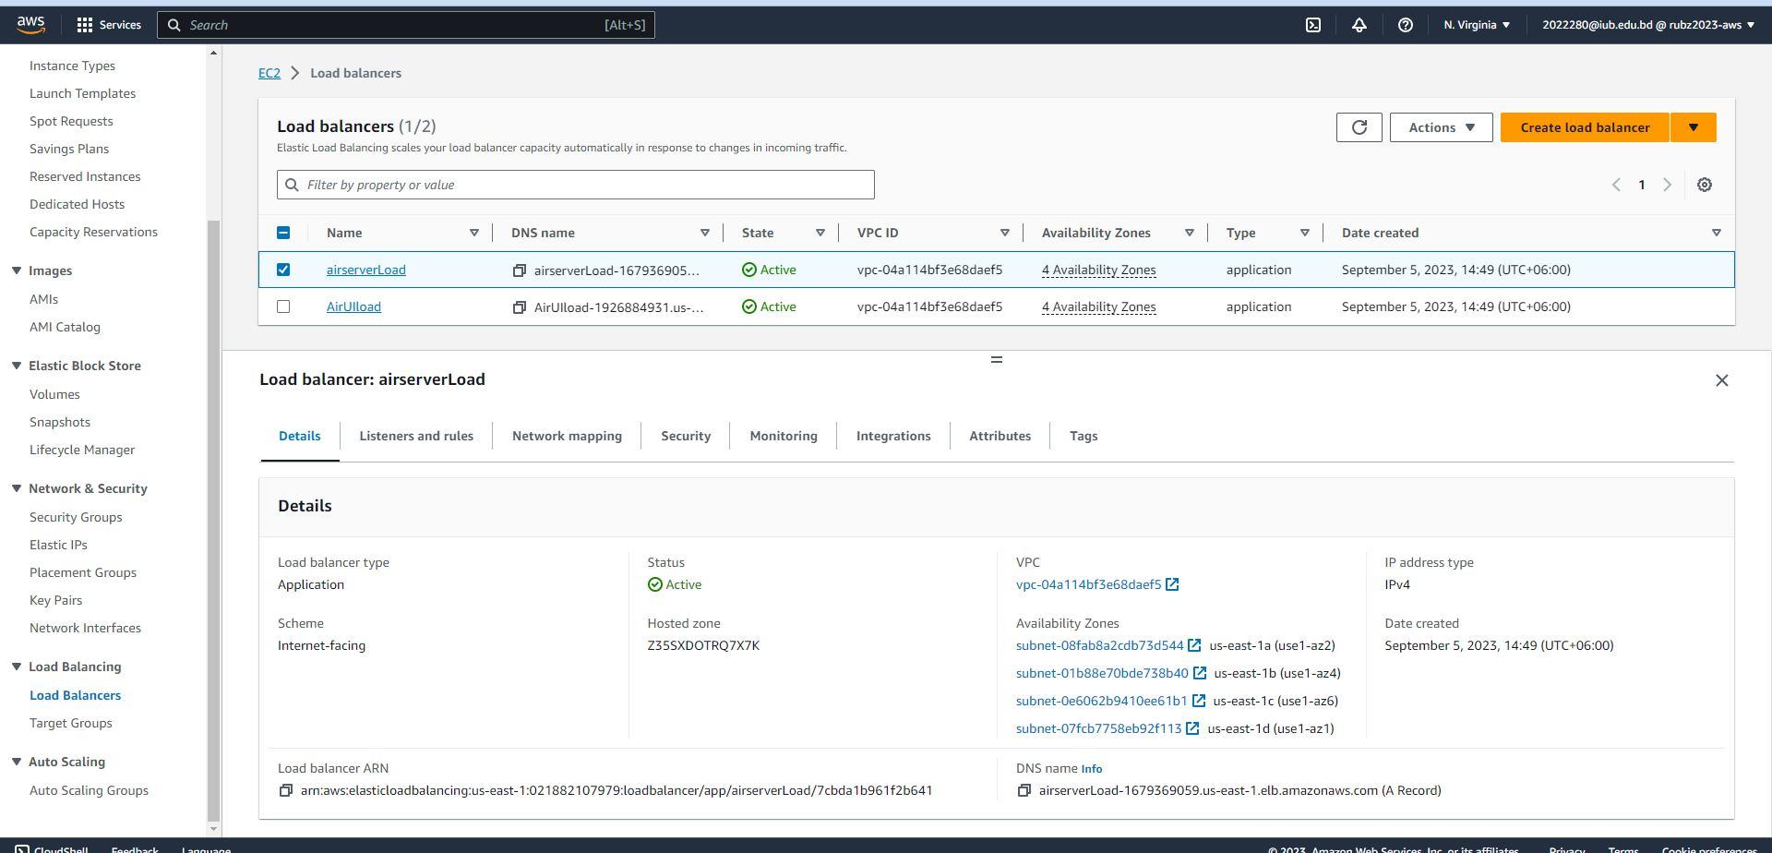
Load Balancer For The Private Instances

Slide 29
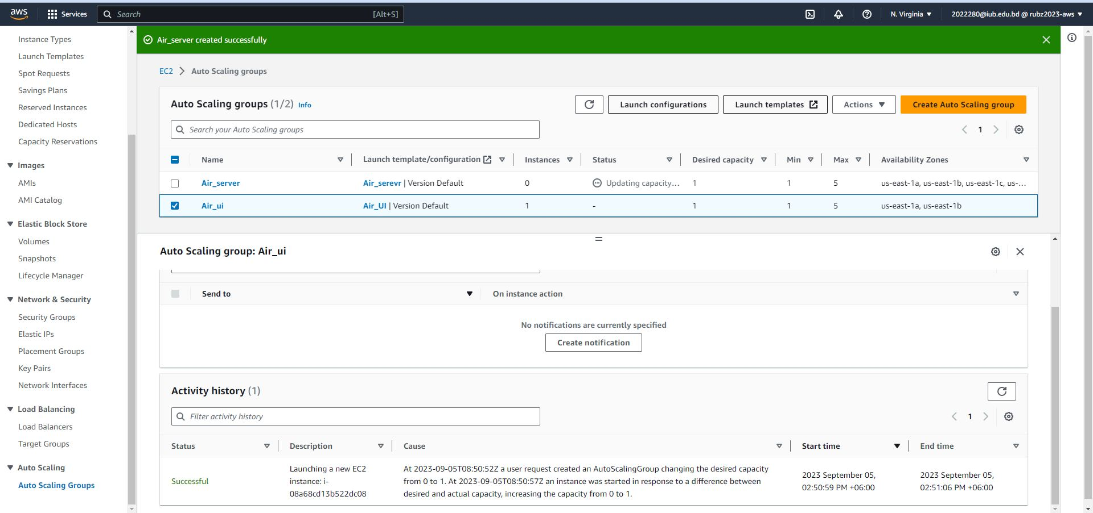
Auto Scaling For The Public Instances

Slide 30
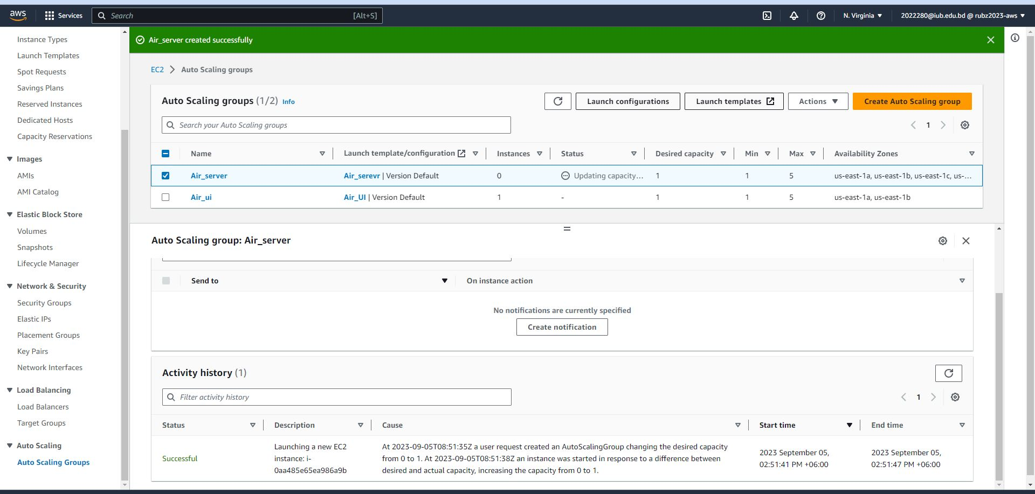
Auto Scaling For The Private Instances

Slide 31
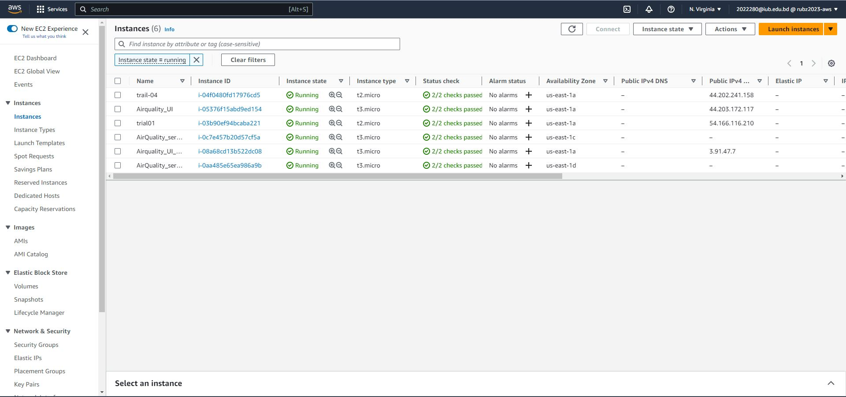
After Auto Scaling Instances

Slide 32


Website

Slide 33
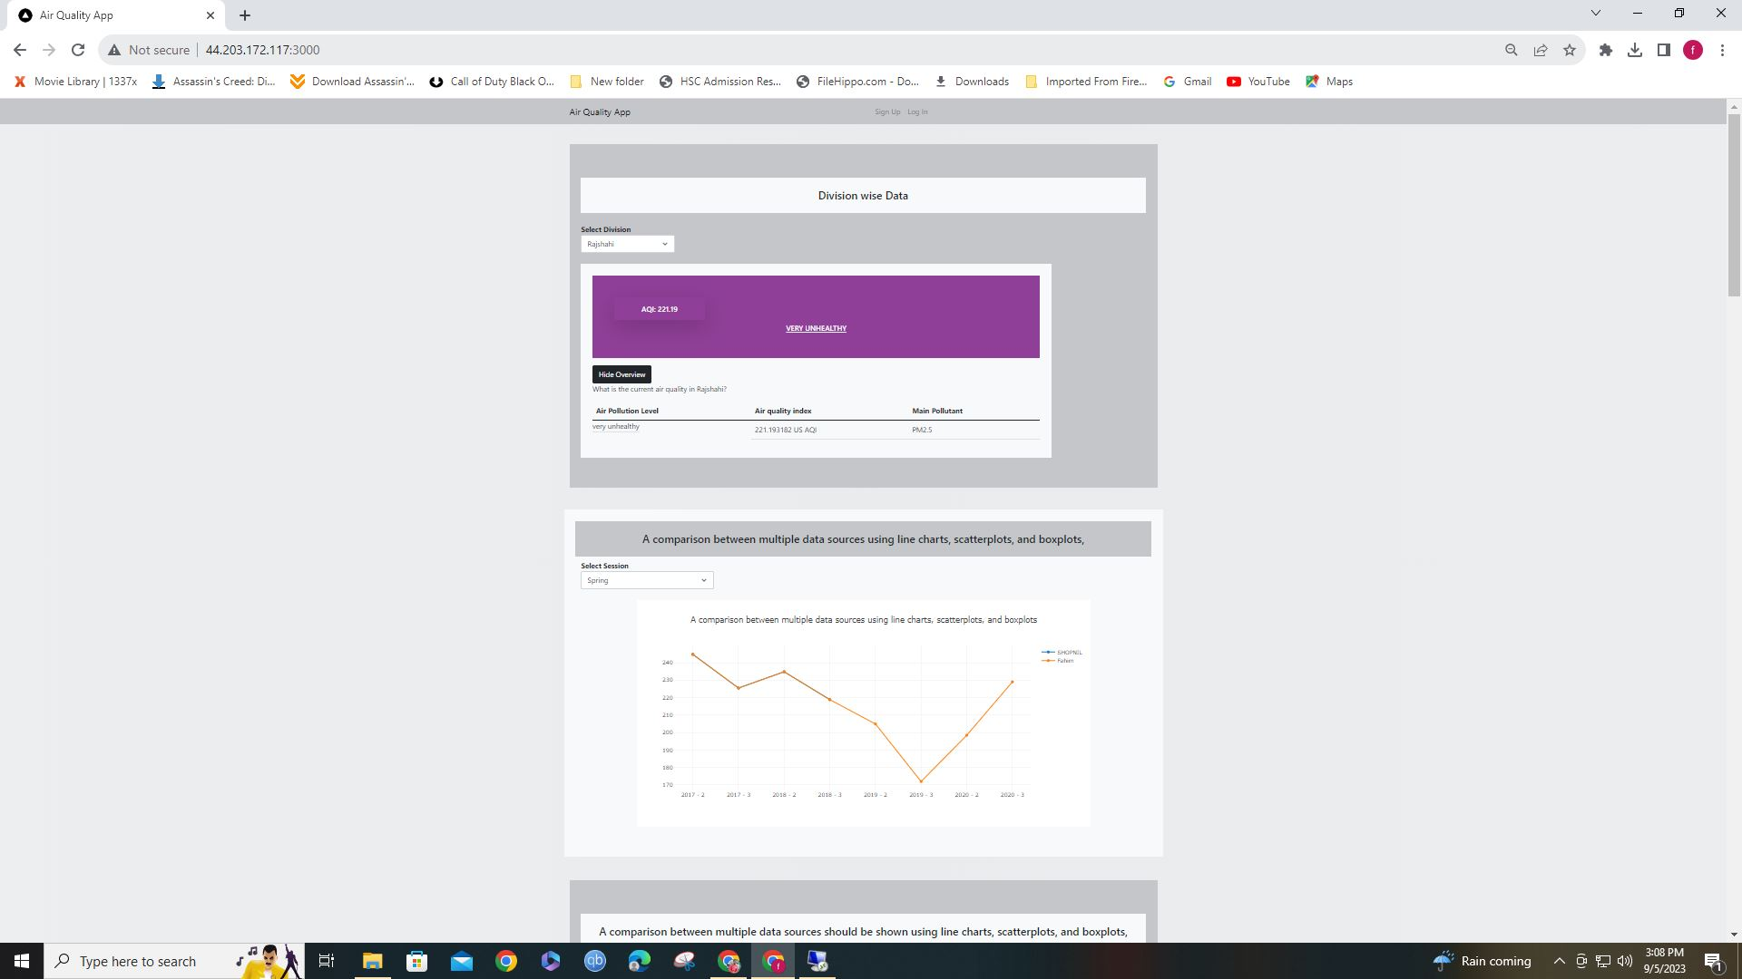
Website Running On The Local Computer

Slide 34
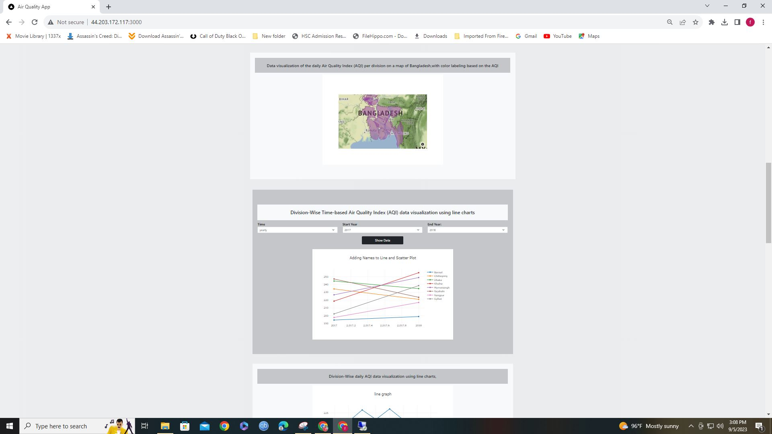
Website Running On The Local Computer

Slide 35
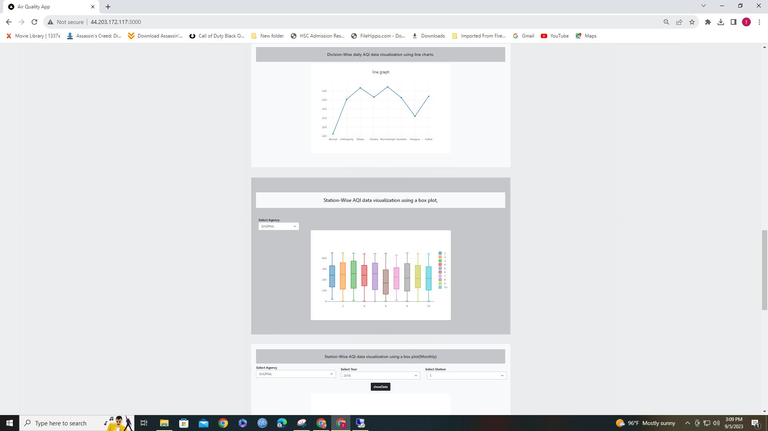
Website Running On The Local Computer

Slide 36
Thank You

